Slide 1
Roadmap for today (adding in renewables)
Forms of fossil fuels (coal, oil, gas)
Forms of renewable fuels: carbohydrates, sugars, alcohols)
How we make electricity from burning fossil fuels (or renewables or nuclear)
What burning has to do with chemical bonds
How we refine the oil we extract from the ground (for burning, and also to make plastics)
How we extract fossil fuels from the ground

Slide 2
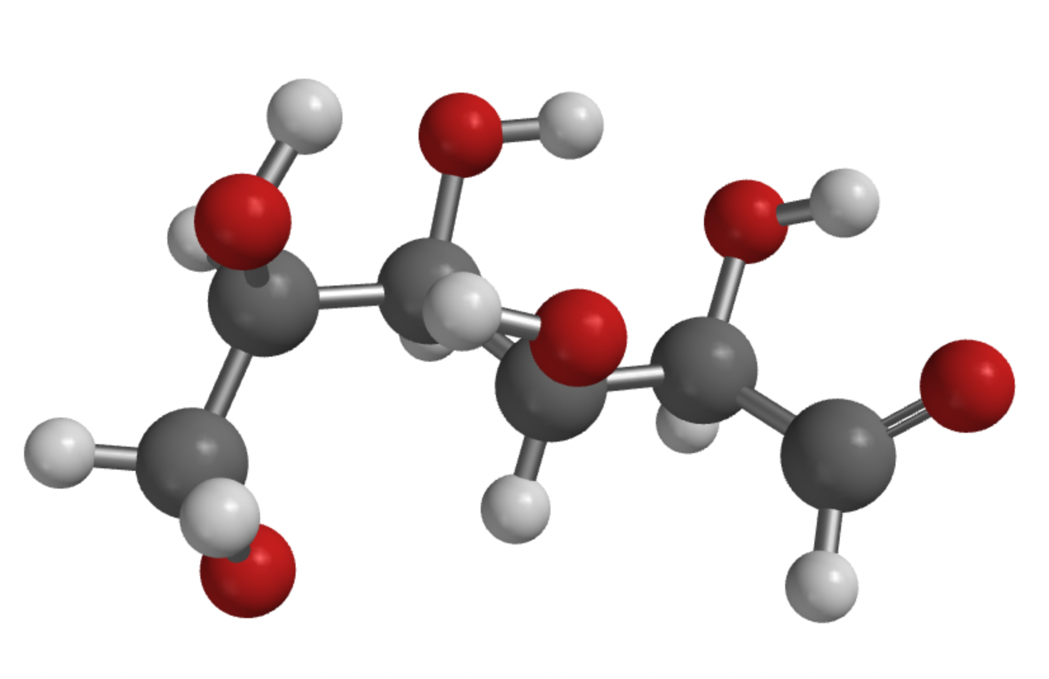
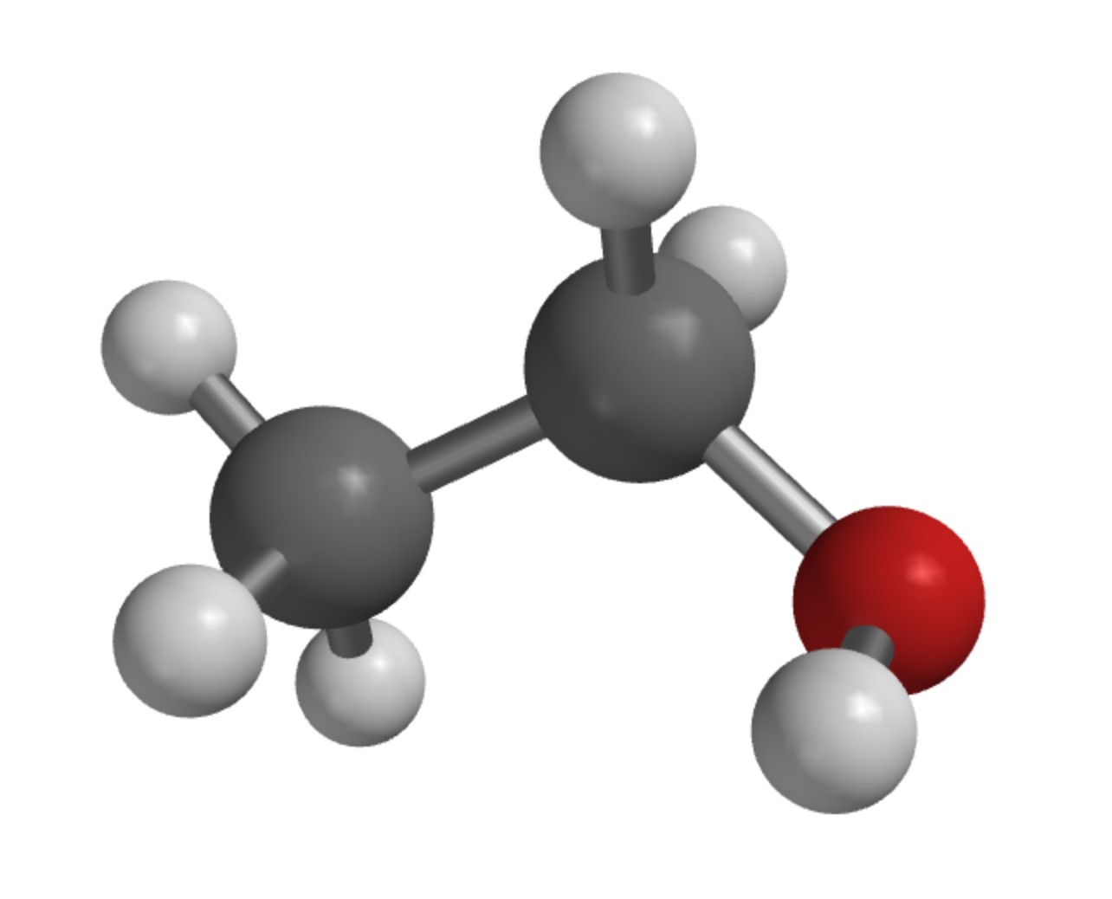
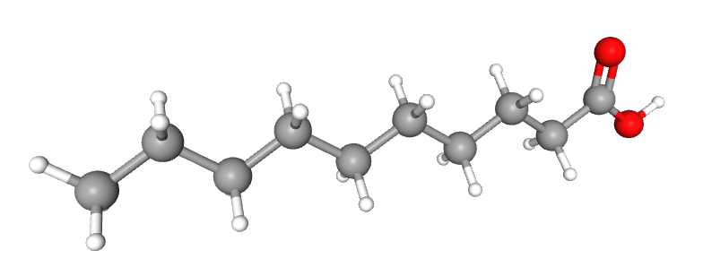
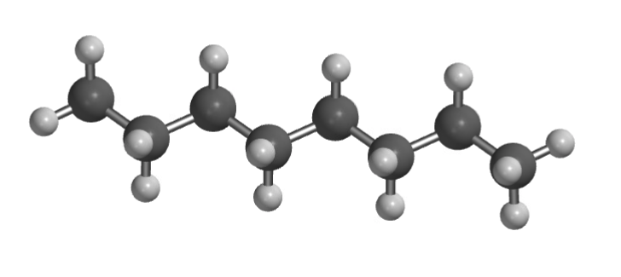
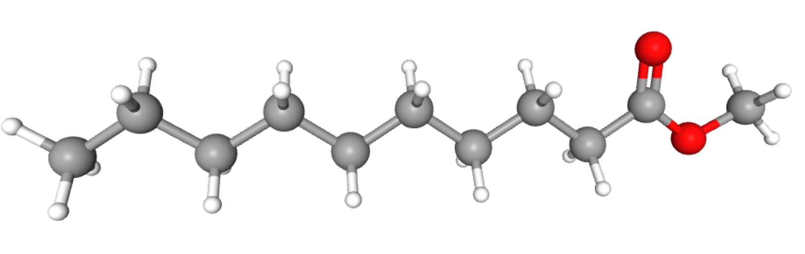
Categories of organic compounds (some are fuels, some just smell nice)
Hydrocarbon
Alcohol
Sugar
Acid
Ester

Slide 3
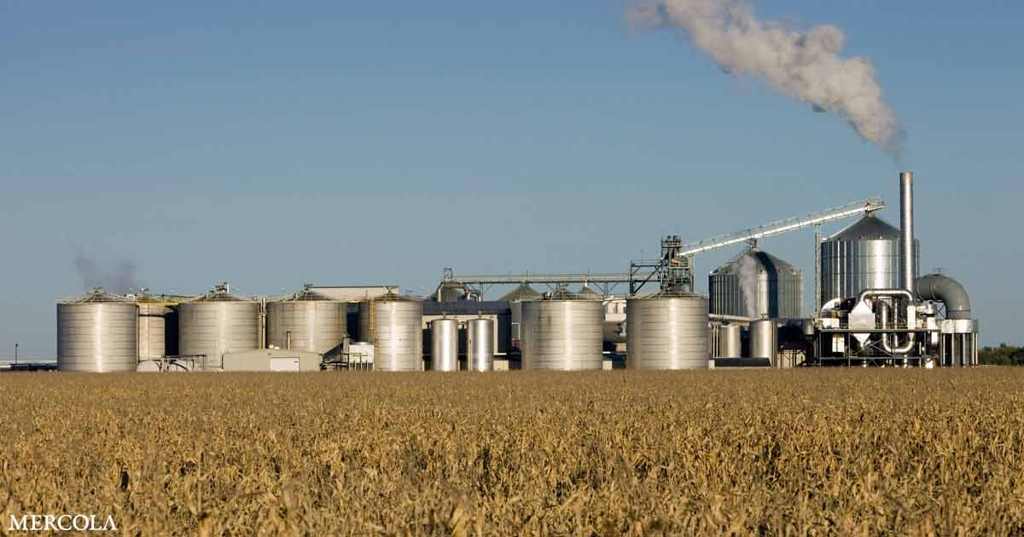
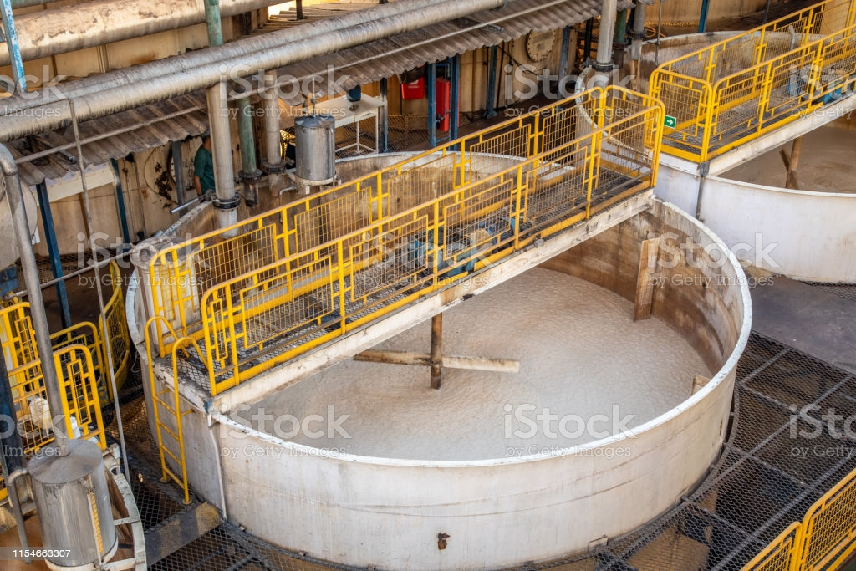
We can ferment sugars, carbohydrates, and cellulosic (leafy) parts

Slide 4
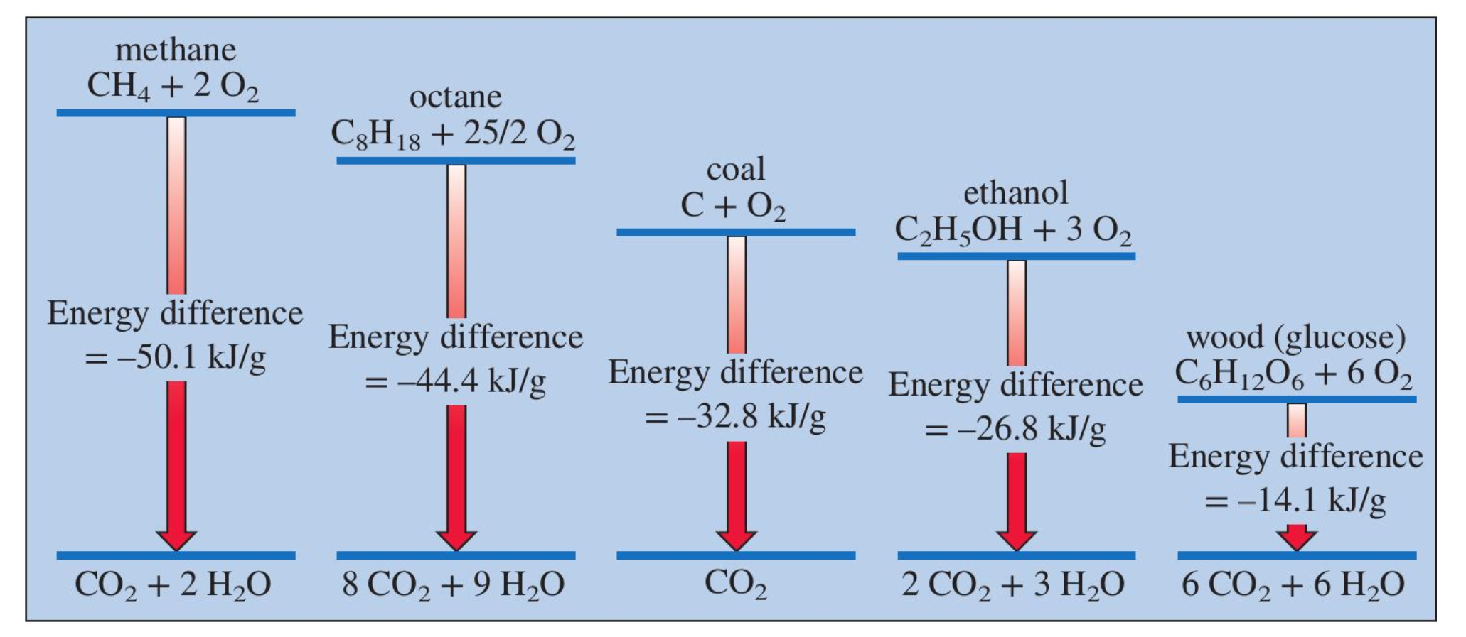
We can ferment sugars, carbohydrates, and cellulosic (leafy) parts

Slide 5
Roadmap for today (adding in renewables)
Forms of fossil fuels (coal, oil, gas)
Forms of renewable fuels: carbohydrates, sugars, alcohols)
How we make electricity from burning fossil fuels (or anything else)
What burning has to do with chemical bonds
How we refine the oil we extract from the ground (for burning, and also to make plastics)
How we extract fossil fuels from the ground

Slide 6
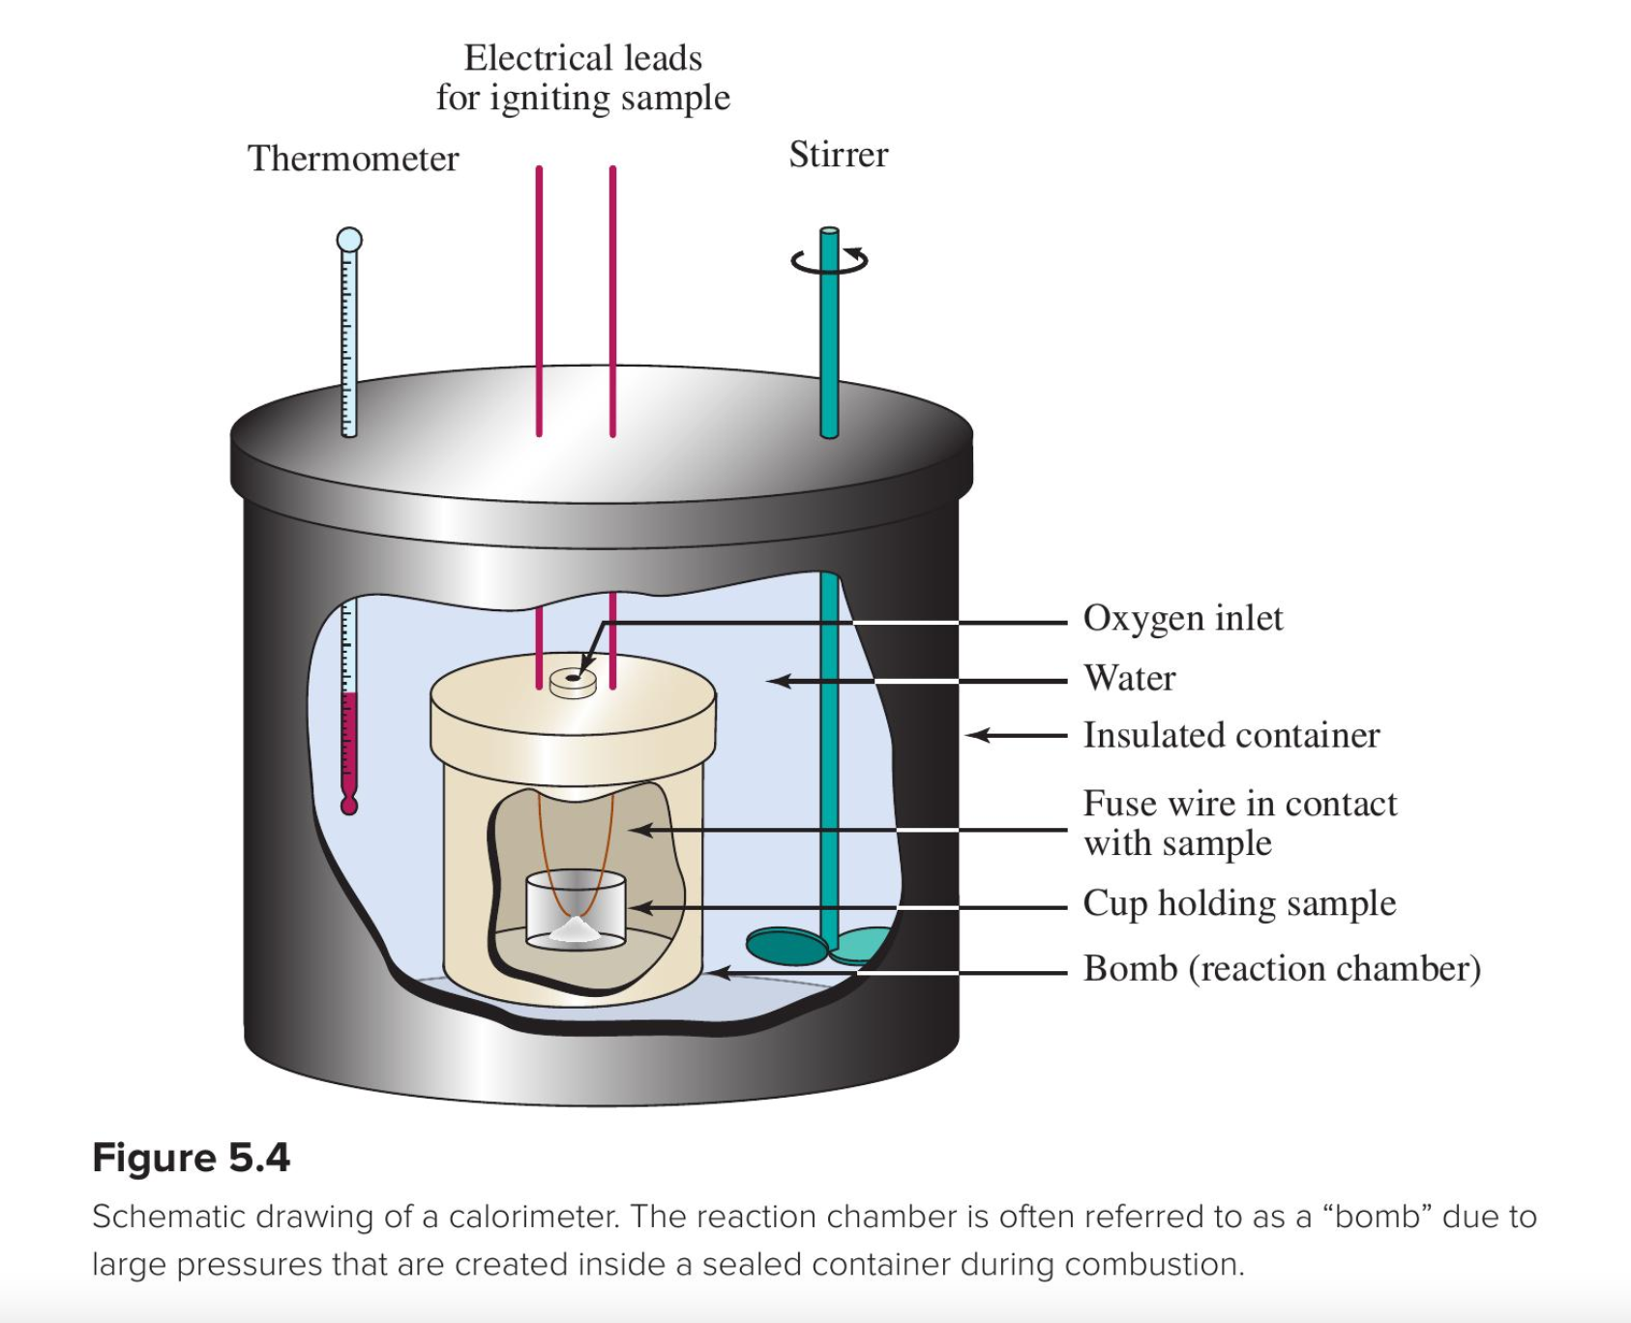

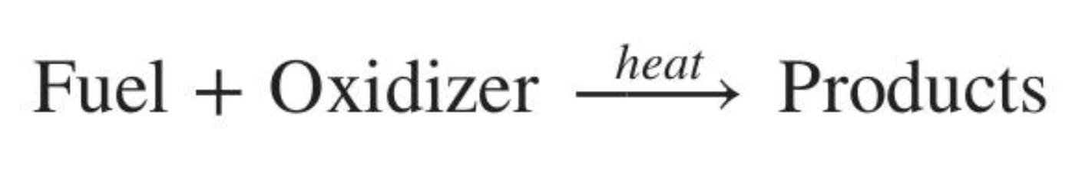
Fuel = something that burns
What burning has to do with chemical bonds
Glucose: C₆H₁₂O₆
Coal: C(s)
Oil/gas: C_{n}H_{m}(l or g)
Usually O₂
(But can be other oxidizers too)
Usually CO₂ and H₂O
(But there can be other products too … including heat!)

Slide 7
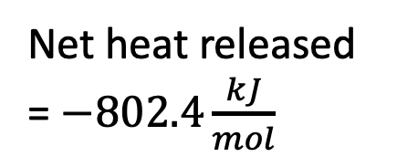
Net heat released is due to the difference in bond strength
What burning has to do with chemical bonds
Bonds breaking
Bonds forming
As long as the bonds forming are stronger than the bonds that are breaking, heat is released!
This is often the case because O=O is pretty weak for a double bond (only 500 kJ/mol), whereas C=O is pretty strong for a double bond (800 kJ/mol)
CH₄ + 2O₂
Net heat released = $−802.4\frac{kJ}{mol}$
Energy
2H₂O + CO₂

Slide 8
How do we know those numbers?
What burning has to do with chemical bonds
Bomb calorimeter
(lab)

Slide 9
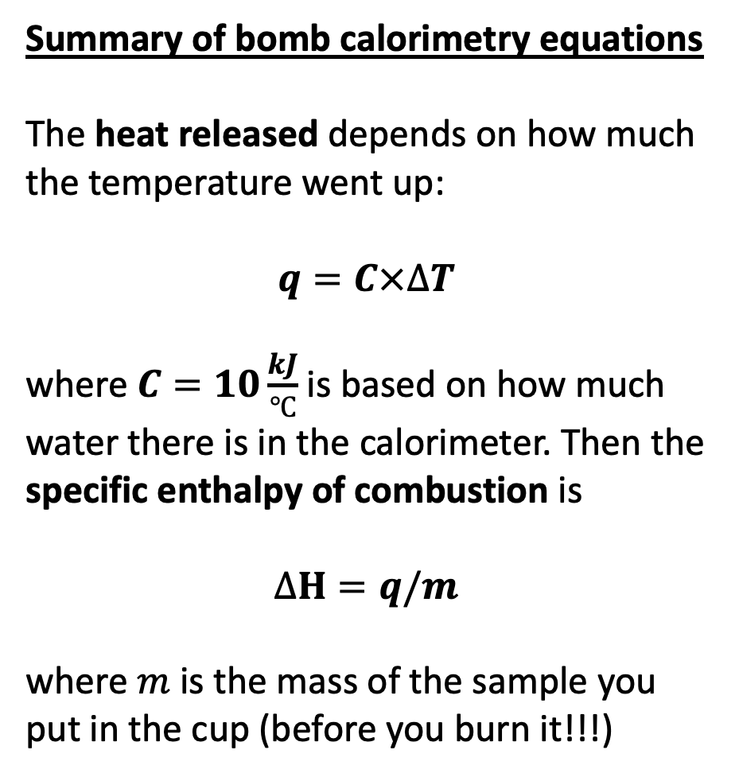
Measuring vs getting info from labels
What burning has to do with chemical bonds
Summary of bomb calorimetry equations
The heat released depends on how much the temperature went up:
$$q=C×∆T$$
where $C=10\frac{kJ}{℃}$ is based on how much water there is in the calorimeter. Then the specific enthalpy of combustion is
$$∆H=q/m$$
where $m$ is the mass of the sample you put in the cup (before you burn it!!!)
Summary of
nutrition equations
1 Calorie = 1 kcal = 1000 calories
1 kcal = 4.18 kJ
The specific enthalpy of combustion (or digestion) is the energy per serving divided by the grams per serving.
Your task … what’s the fuel with the highest specific enthalpy of combustion (also called energy density): wood pellets, cooking oil, or option #3? How do they compare with fossil fuels?

Slide 10
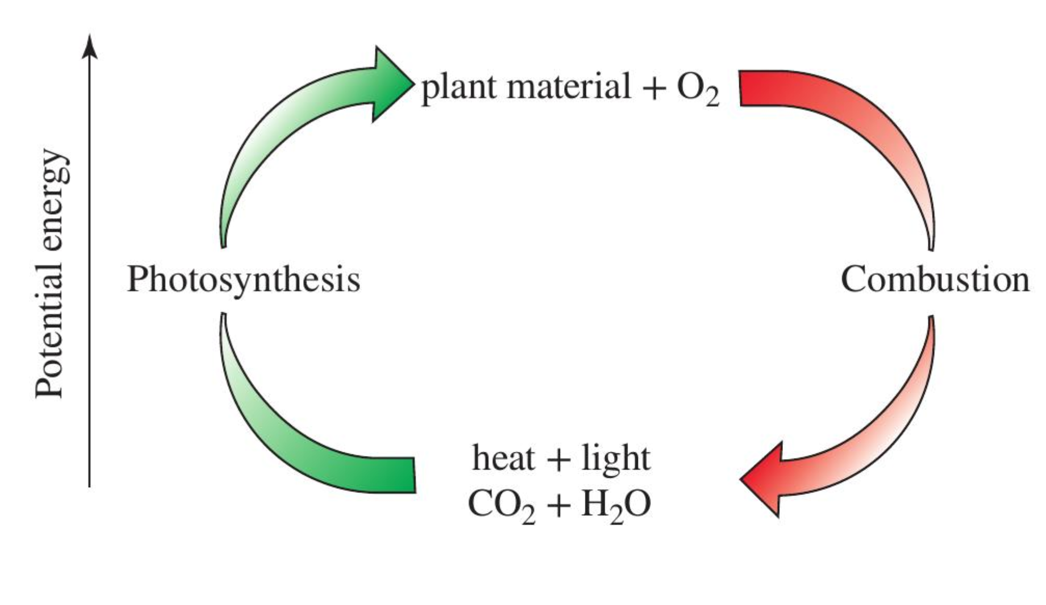
Energy density per gram
What burning has to do with chemical bonds
Olive oil
Alcohol (ethanol)
Wood pellets, cookies

Slide 11
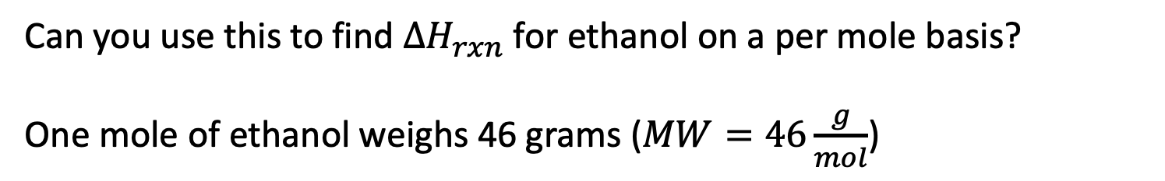
Converting energy density per gram to per mole of fuel
What burning has to do with chemical bonds
Can you use this to find $∆H_{rxn}$ for ethanol on a per mole basis?
One mole of ethanol weighs 46 grams ($MW=46\frac{g}{mol}$)

Slide 12
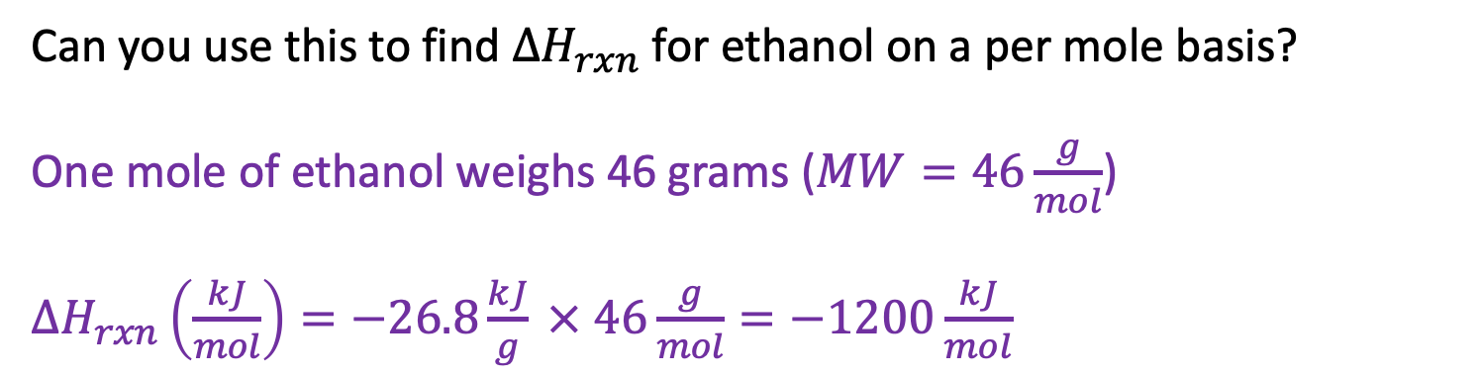
Converting energy density per gram to per mole of fuel
What burning has to do with chemical bonds
Can you use this to find $∆H_{rxn}$ for ethanol on a per mole basis?
One mole of ethanol weighs 46 grams ($MW=46\frac{g}{mol}$)
$∆H_{rxn}\left(\frac{kJ}{mol}\right)=−26.8\frac{kJ}{g} × 46\frac{g}{mol}=−1200\frac{kJ}{mol}$

Slide 13
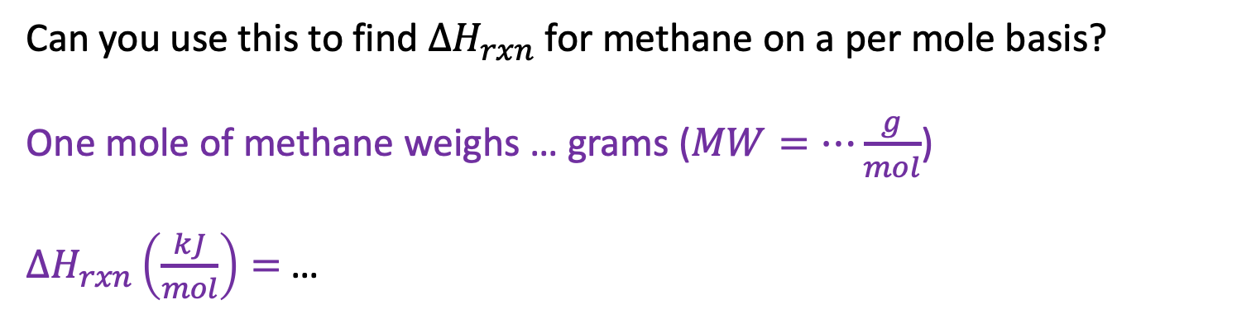
Converting energy density per gram to per mole of fuel
What burning has to do with chemical bonds
Can you use this to find $∆H_{rxn}$ for methane on a per mole basis?
One mole of methane weighs … grams ($MW=…\frac{g}{mol}$)
$∆H_{rxn}\left(\frac{kJ}{mol}\right)=$ …

Slide 14
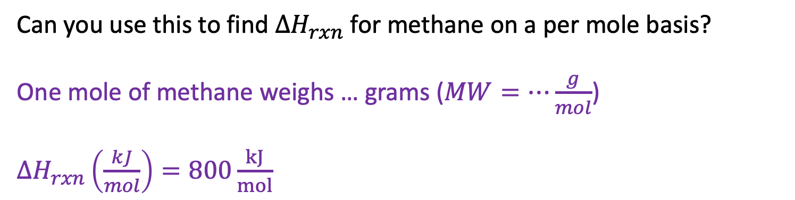
Converting energy density per gram to per mole of fuel
What burning has to do with chemical bonds
Can you use this to find $∆H_{rxn}$ for methane on a per mole basis?
One mole of methane weighs … grams ($MW=…\frac{g}{mol}$)
$∆H_{rxn}\left(\frac{kJ}{mol}\right)=800\frac{kJ}{mol}$

Slide 15
Roadmap for today (adding in renewables)
Forms of fossil fuels (coal, oil, gas)
Forms of renewable fuels: carbohydrates, sugars, alcohols)
How we make electricity from burning fossil fuels (or renewables or nuclear)
What burning has to do with chemical bonds
How we refine the oil we extract from the ground (for burning, and also to make plastics)
How we extract fossil fuels from the ground

Slide 16
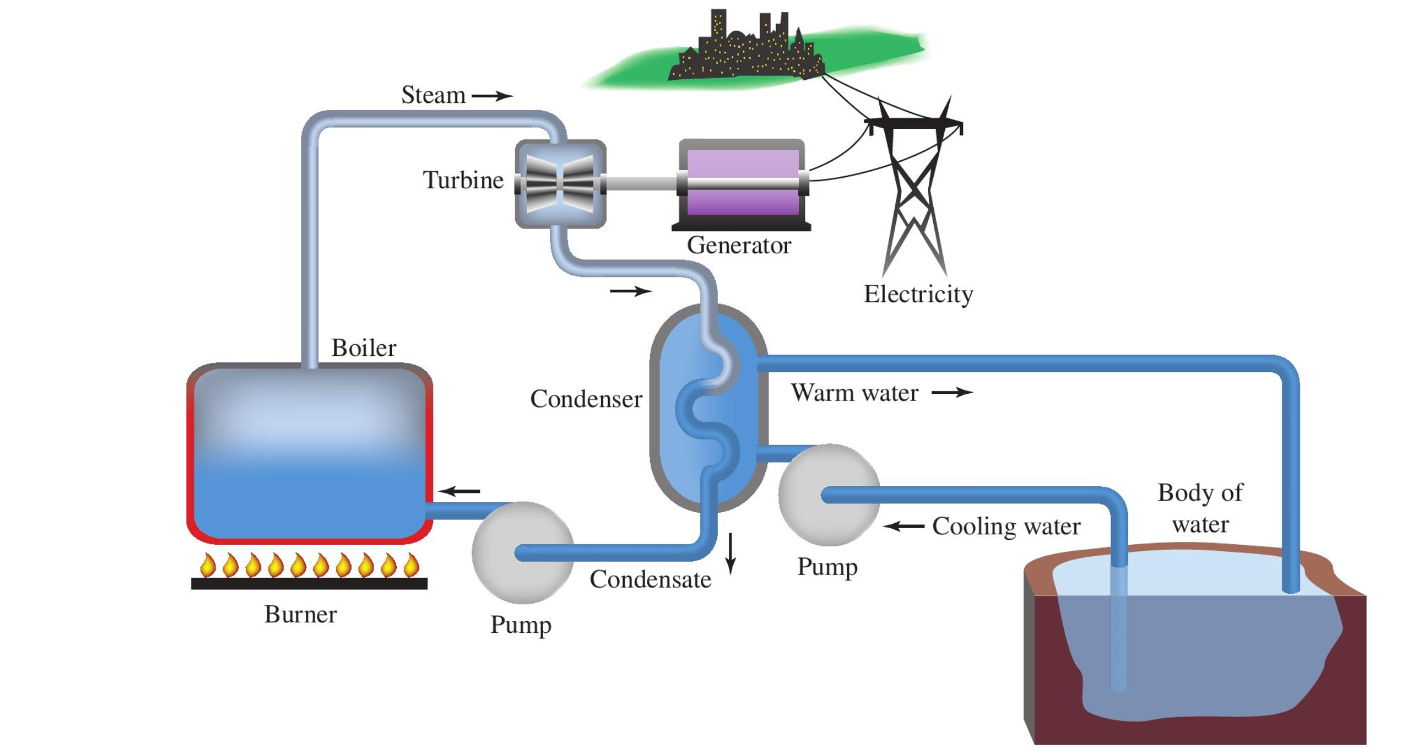
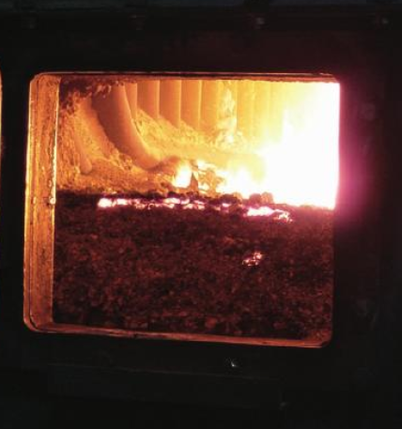
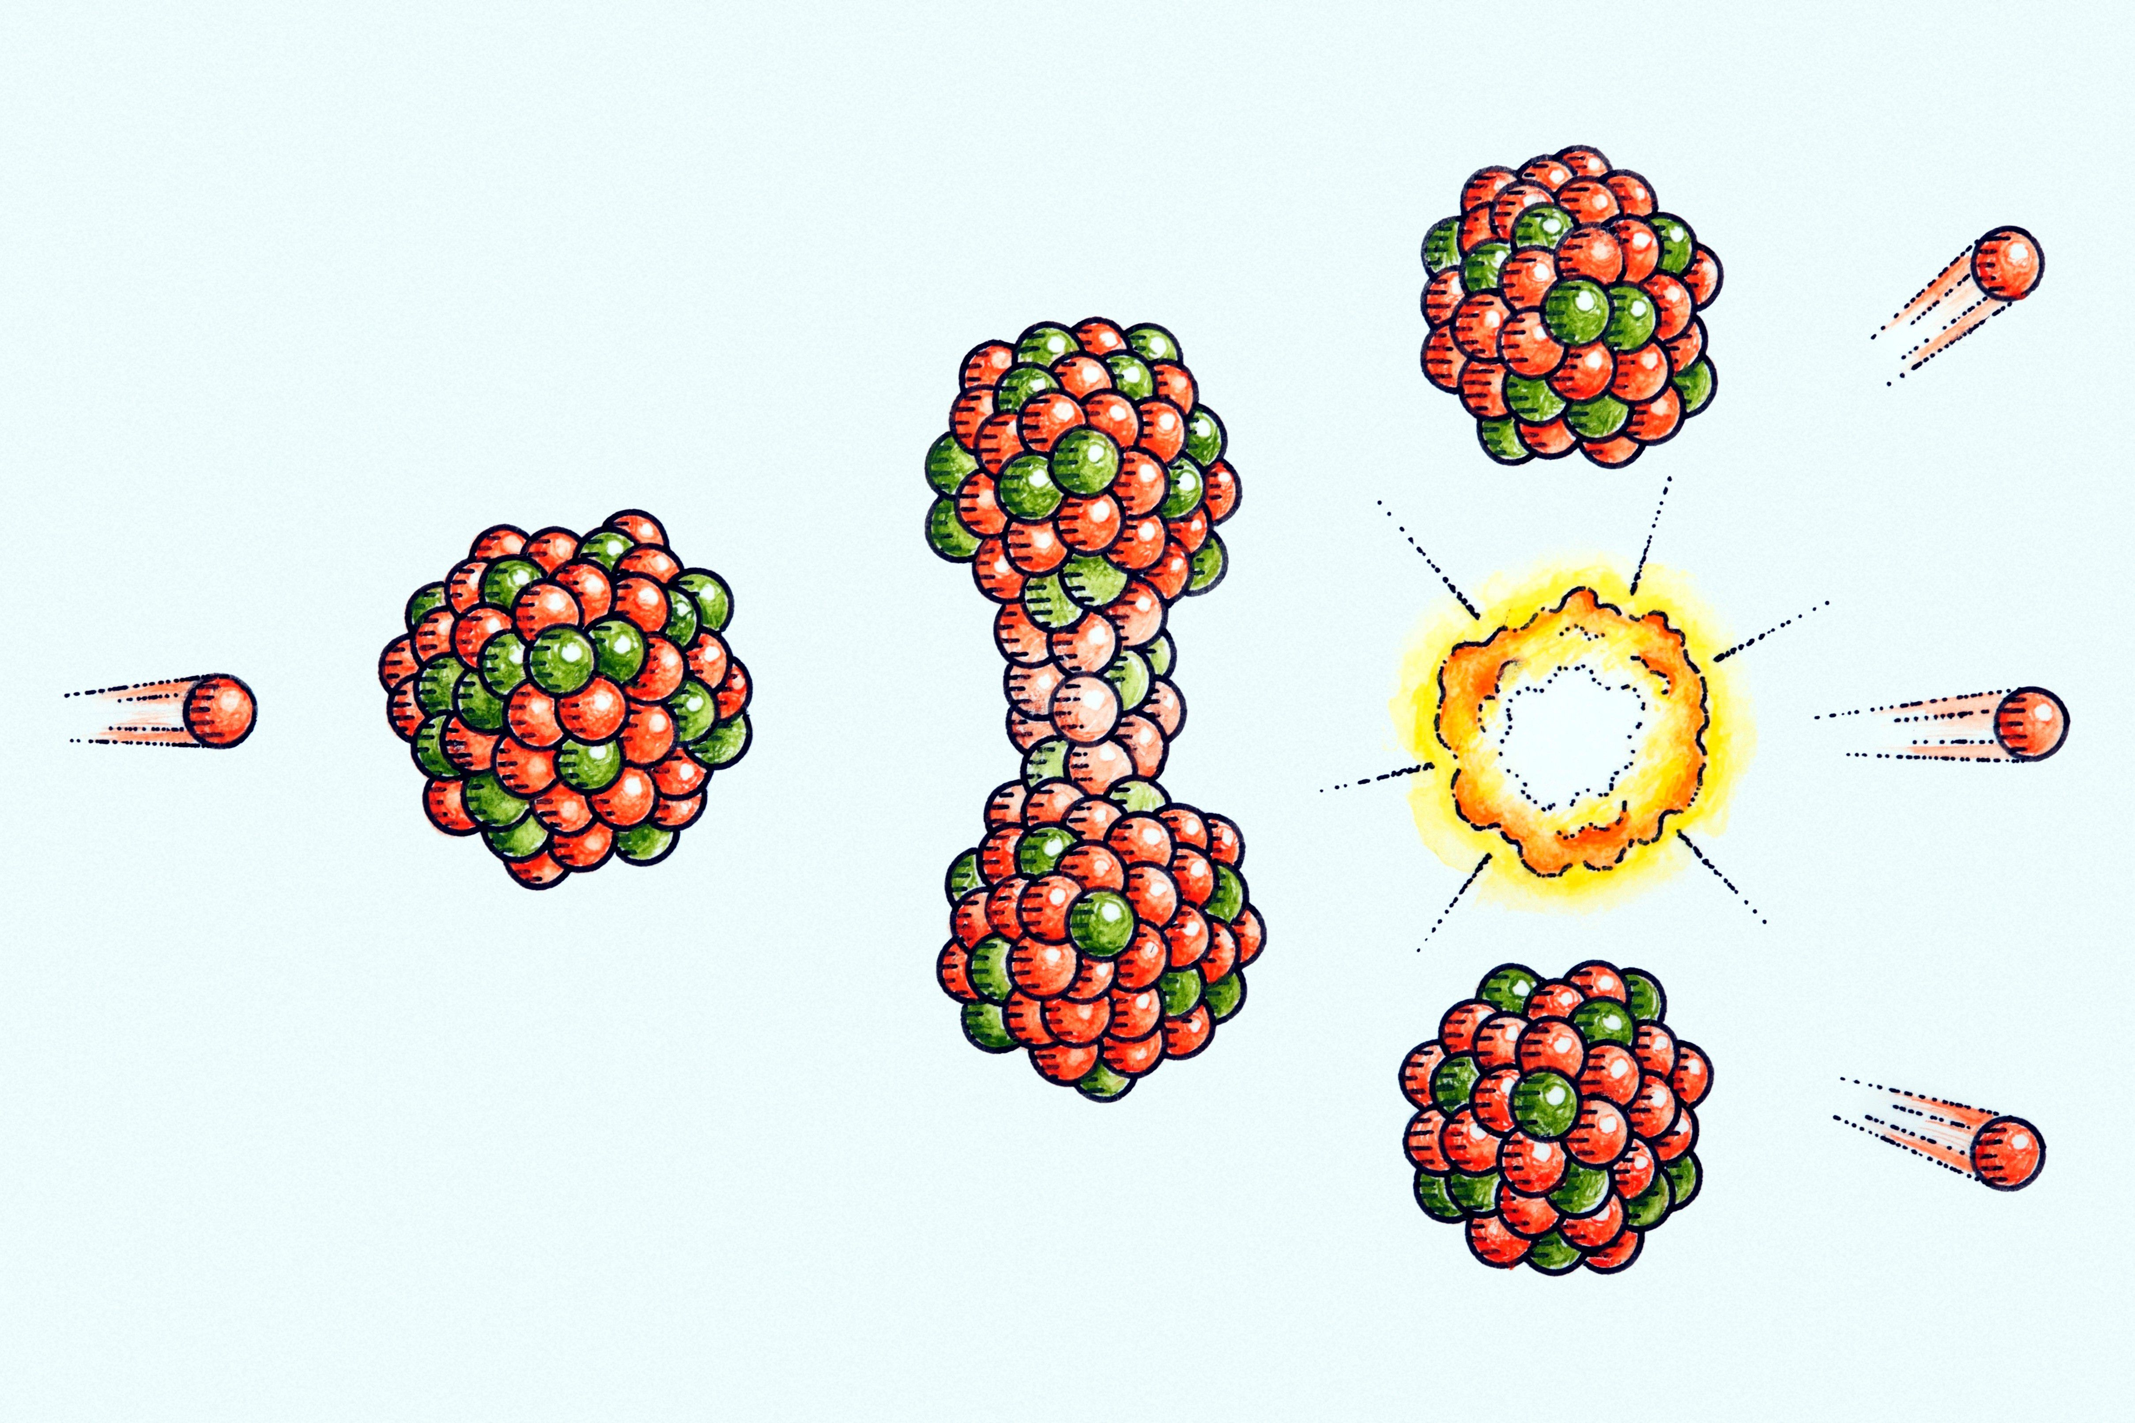
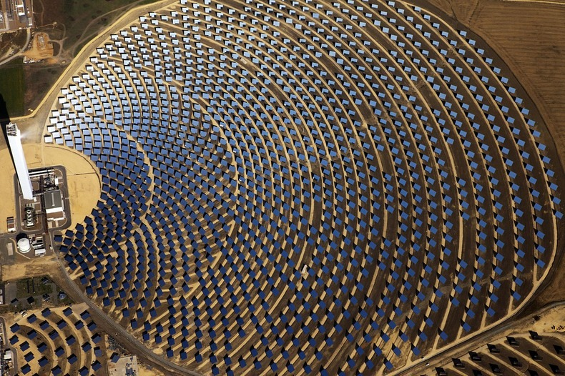
How we make electricity from burning fossil fuels (or renewables or nuclear)
Burning coal/oil/gas or burning biofuel
or collecting solar
Nuclear fission
Solar energy

Slide 17
Roadmap for today (adding in renewables)
Forms of fossil fuels (coal, oil, gas)
Forms of renewable fuels: carbohydrates, sugars, alcohols)
How we make electricity from burning fossil fuels (or renewables or nuclear)
What burning has to do with chemical bonds
How we refine the oil we extract from the ground (for burning, and also to make plastics)
How we extract fossil fuels from the ground

Slide 18
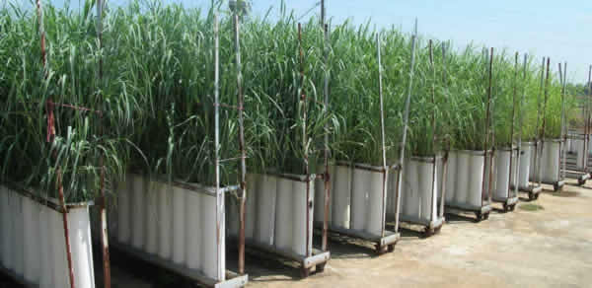
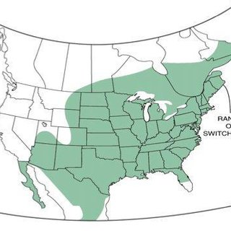
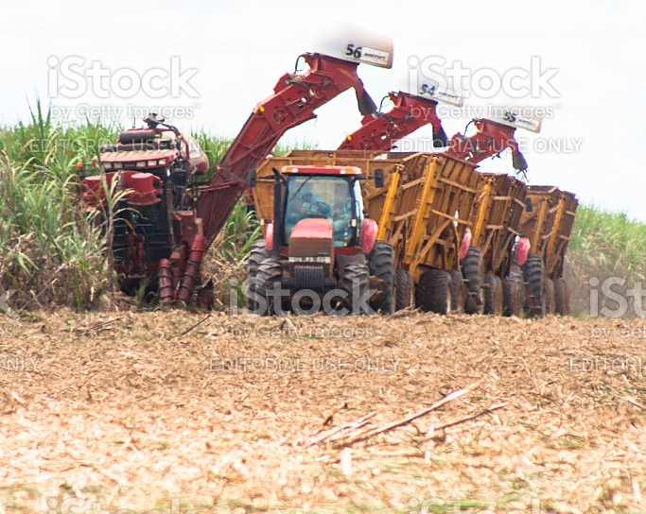
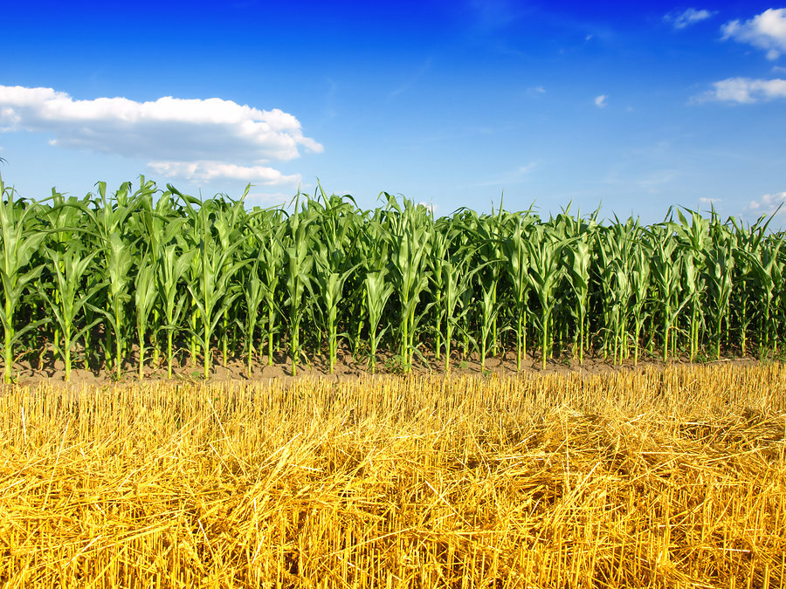

Ethics of biofuels: many are also food, or replace food crops
Switchgrass
Fruit
Corn
Sugarcane

